Slide 1
JavaScript

Slide 2
Why JavaScript?
JavaScript is one of 3 languages all web developers MUST learn:
HTML to define the content of web pages
CSS to specify the layout of web pages
JavaScript to program the behavior of web pages

Slide 3
What JavaScript can do?
JavaScript Can Change HTML Elements
JavaScript Can Change HTML Attributes
JavaScript Can Change HTML Styles (CSS)
JavaScript Can Validate Data

Slide 4
The <script> tag
<!DOCTYPE html> <html> <body> <h1>My Web Page</h1> <p id="demo">A Paragraph</p> <button type="button" onclick="myFunction()">Try it</button> <script> function myFunction() { document.getElementById("demo").innerHTML = "Paragraph changed."; } </script> </body> </html>

Slide 5
External JavaScripts
Scripts can also be placed in external files.
External scripts are practical when the same code is used in many different web pages.
JavaScript files have the file extension .js.
To use an external script, put the name of the script file in the source (src) attribute of the <script> tag:
Example
<!DOCTYPE html> <html> <body> <script src="myScript.js"></script> </body> </html>

Slide 6
JavaScript Output
Manipulating HTML Elements
To access an HTML element from JavaScript, you can use the document.getElementById(id) method.
Use the "id" attribute to identify the HTML element, and innerHTML to refer to the element content:
Writing to the HTML Document
<script> document.write(Date()); </script>

Slide 7
JavaScript Literals
Number literals can be written with or without decimals, and with or without scientific notation (e): 3.14, 1001, 123e5
String literals can be written with double or single quotes: “John Snow”, ‘John Snow’
Expression literals evaluates (computes) to a value: 5+6, 5*6
Array literals defines an array: [40, 100, 1, 5, 25, 10]
Object literals defines an object: {firstName:"John", lastName:“Snow", age:20, eyeColor:"blue"}
Function literals defines a function: function myFunction(a, b) { return a * b;}

Slide 8
JavaScript Variables
In a programming language, named variables stores data values.
JavaScript uses the var keyword to define variables, and an equal sign to assign values to variables (just like algebra):
var x, length x = 5 length = 6

Slide 9
JavaScript Data types
var length = 16; // Number assigned by a number literal
var points = x * 10; // Number assigned by an expression literal
var lastName = "Johnson"; // String assigned by a string literal
var cars = ["Saab", "Volvo", "BMW"]; // Array assigned by an array literal
var person = {firstName:”John”, lastName:”Snow”}; // Object assigned by an object literal

Slide 10
JavaScript Objects
In JavaScript, objects are data (variables), with properties and methods.
In JavaScript you can also create your own objects.
This example creates an object called "person", and adds four properties to it:
Example
var person = {firstName:"John", lastName:"Doe", age:50, eyeColor:"blue"};
Accessing Object Properties
name = person.lastName; name = person["lastName"]; Accessing Object Methods
name = person.fullName();

Slide 11
JavaScript Function
JavaScript statements written inside a function, can be invoked many times (reused):
Invoke a function = Call upon a function (ask for the code in the function to be executed).
function myFunction(a, b) { return a * b; // returns the product of a and b }

Slide 12
JavaScript Scope
Local JavaScript Variables
Variables declared within a JavaScript function, become LOCAL to the function.
Local variables have local scope: They can only be accessed within the function.
Example
// code here can not use carName function myFunction() { var carName = "Volvo"; // code here can use carName }
Global JavaScript Variables
A variable declared outside a function, becomes GLOBAL.
A global variable has global scope: All scripts and functions on a web page can access it.
Example
var carName = " Volvo"; // code here can use carName function myFunction() { // code here can use carName }

Slide 13
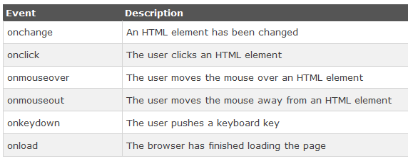
JavaScript Events
JavaScript can react to these HTML events:
An HTML web page has finished loading
An HTML input field was changed
An HTML button was clicked

Slide 14
JavaScript Strings
Strings can be objects.
var x = "John"; var y = new String("John");

Slide 15
Useful String Methods
var str = “ ………………………”;
Finding a string in a string → str.indexOf(“…….”); str.lastIndexOf(“………”);
Searching for string content → str.search(“………");
Extracting Strings → str.slice(start, end); str.substr(start, length);
Replacing Content → str.replace(“old”,”new”);
Converting upper and lower case → str.toUpperCase(); str.toLowerCase();
Converting a string to an Array → str.split(“,”);

Slide 16
JavaScript Numbers
JS Numbers are always 64-bit floating point numbers
Hexadecimal numbers → var x = 0xFF; // x will be 255
Infinity → a number outside the largest possible number.
NaN → Not a Number
Numbers can be objects → var y = new Number(123);

Slide 17
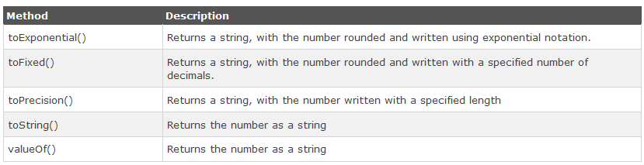
Number Methods
Converting variables to numbers:
The Number() method
The parseInt() method
The parseFloat() method

Slide 18
JavaScript Math
Math.random(); // returns a random number
Math.min(0, 150, 30, 20, -8); // returns -8
Math.max(0, 150, 30, 20, -8); // returns 150
Math.round(4.7); // returns 5
Math.ceil(4.4); // returns 5
Math.floor(4.7); // returns 4

Slide 19
JavaScript Date
new Date()
new Date(milliseconds)
new Date(dateString)
new Date(year, month, day, hours, minutes, seconds, milliseconds)
toUTCString();
toDateString();

Slide 20
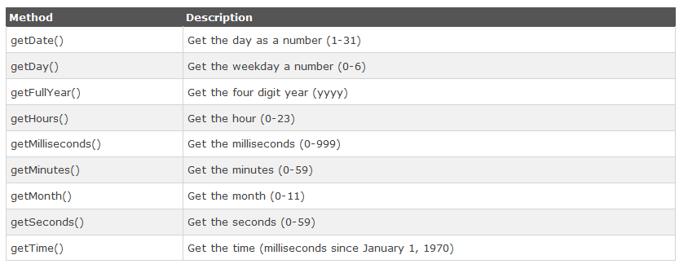
JavaScript Date Methods

Slide 21
JavaScript Arrays
var array-name = [item1, item2, ...];
var index; var fruits = ["Banana", "Orange", "Apple", "Mango"]; for (index = 0; index < fruits.length; ++index) { text += fruits[index]; }

Slide 22
JavaScript Array Methods
var fruits = ["Banana", "Orange","Apple", "Mango"];
Converting array as Strings → fruits.valueOf(), fruits.toString(), fruits.join(“*”)
Removes the last element → fruits.pop();
Adds a new element → fruits.push("Kiwi");
Shifting elements → fruits.shift(); // remove first element
Unshifting elements → fruits.unshift("Lemon"); // add lemon at the beginning
delete an element → delete fruits[0];
Splicing an array → fruits.splice(2, 0, "Lemon", "Kiwi"); // add two elements starting from 2 and remove 0 elements

Slide 23
JavaScript Array Methods
Sorting an array → fruits.sort(); // Sorts the elements of fruits
Reversing an array → fruits.reverse(); // Reverses the order of the elements
Numeric Sort → var points = [40, 100, 1, 5, 25, 10]; points.sort(function(a, b){return a-b});
Slicing an array → fruits.slice(1,3);
Concatenating arrays → var myGirls = ["Cecilie", "Lone"]; var myBoys = ["Emil", "Tobias","Linus"]; var myChildren = myGirls.concat(myBoys);

Slide 24
JavaScript Conditional Statement
Syntax
if (condition1) { block of code to be executed if condition1 is true } else if (condition2) { block of code to be executed if the condition1 is false and condition2 is true } else { block of code to be executed if the condition1 is false and condition2 is false }

Slide 25
JavaScript for Loop
for (initialization; condition; increment/decrement) { code block to be executed }
var i;
for (i = 0; i < 5; i++) {
document.write("The number is " + i + "<br>”);
}

Slide 26
JavaScript while Loop
while (condition) { code block to be executed }
while (i < 10) { document.write("The number is " + i); i++; }

Slide 27
Reference
Chapter 4 of WEB TECHNOLOGIES: A Computer Science Perspective by Jeffrey C. Jackson

Slide 28
Assignment (Optional)
Create a web-based calculator/ Photo Album/ Tic tac toe/ Any Game using JavaScript and other necessary tools.
Submission Deadline: July 20 2014
Email to bijon_sust@yahoo.com mention Your student ID in the subject line

